Slide 1
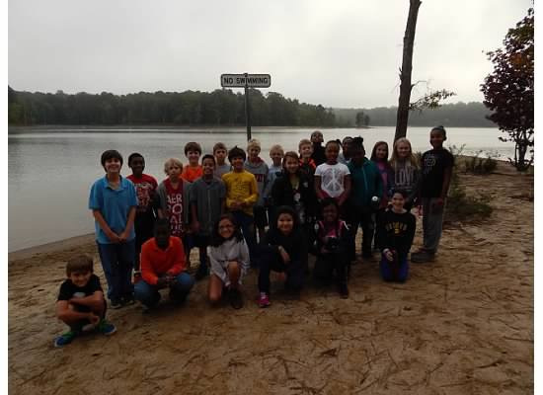
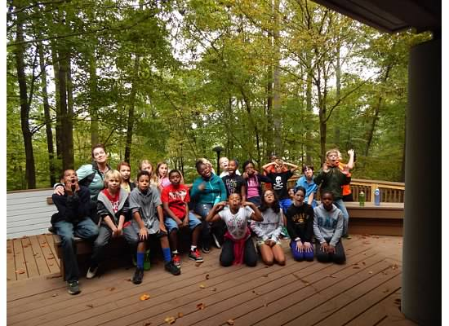
Blue Jay Point
Overnight Field Trip http://www.wakebvgov.com/parks/bluejay/default.htm
Little Monday, October 12-13
Vicinus Tuesday, October 13-14
Cardello Monday, October 19-20
Page Tuesday, October 20-21

Slide 2
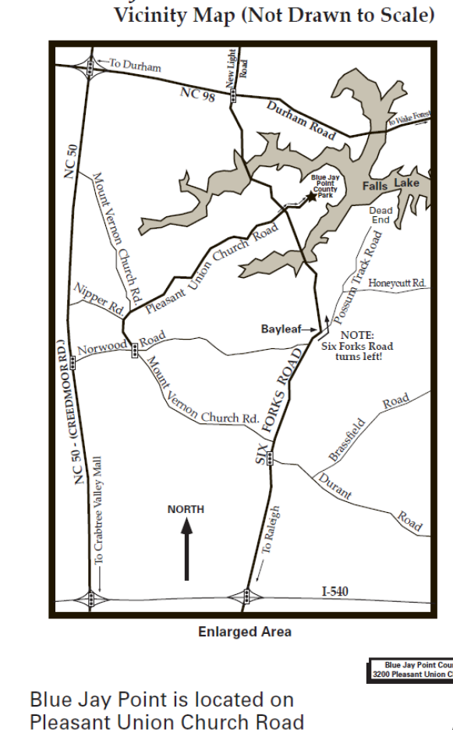
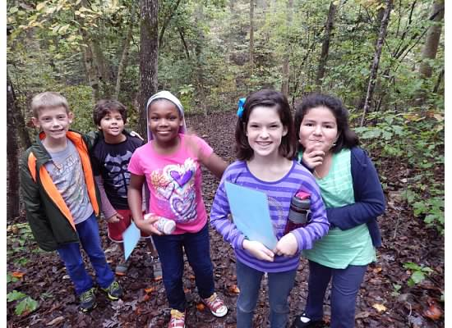
Where Is Blue Jay Point County Park?
Take Hwy. I-440 Outer or I-540 West.
Exit onto Six Forks Rd., heading NORTH, out of Raleigh
Continue on Six Forks Rd., approx. 2.5 mi. after I-540.
Now there should be a sign for Hwy-98 and a Marathon gas station on the right and the Bay Leaf Volunteer Fire Station and water tower on the left. At this point, take a physical LEFT turn onto Six Forks Rd. (from Six Forks Rd.). If you had continued straight, you would have been on Possum Track Rd.
Continue to follow Six Forks Rd. across one bridge over the Lake. At the next full street intersection, take a RIGHT onto Pleasant Union Church Rd.
This road will take you into the park.

Slide 3
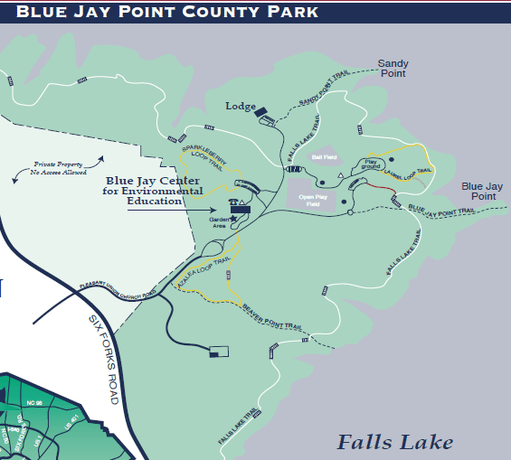
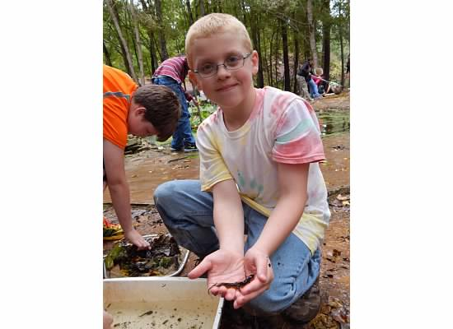

Slide 4
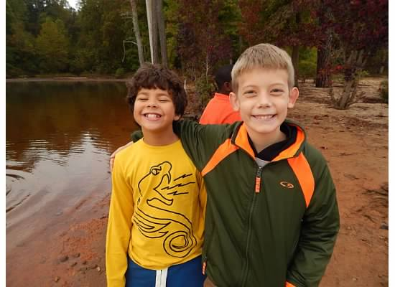
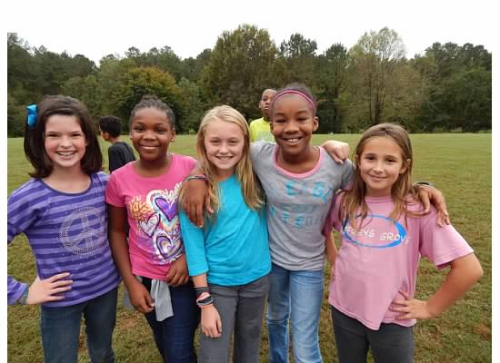
Leader Orientation Workshop
Each homeroom teacher has visited the park and completed the LOW (leader orientation workshop) training.
We have worked with the Blue Jay staff to create an agenda for the two day trip, toured the facilities, and reviewed park rules and emergency procedures.

Slide 5
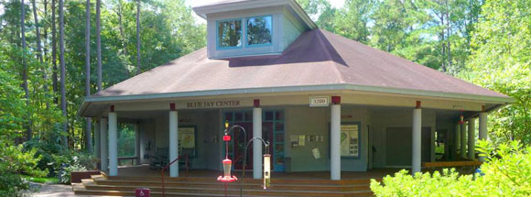
Day 1 Sample Agenda
11:00 Leave school
11:20 Arrive at BJP; pick up Discovery Boxes
11:45-12:15 Lunch at the picnic tables
12:15-1:00
Playground
Quick Frozen Critters in field
(Rain: “Mind’s Eye” on Porch and work in activity book)
1:00-2:00 Lodge
Pick up keys, check-in, unpack, establish ground rules meeting, prepare for hike
2:00-3:00 Habitat Hike (Staff Led)
We must complete 6 environmental education activities during our stay!

Slide 6
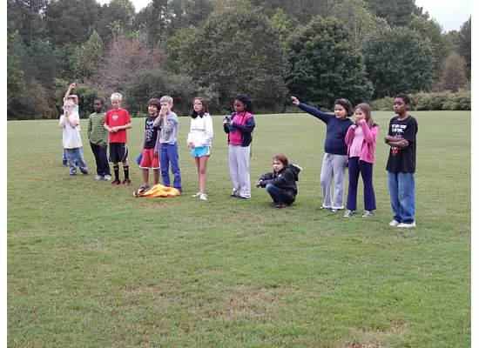
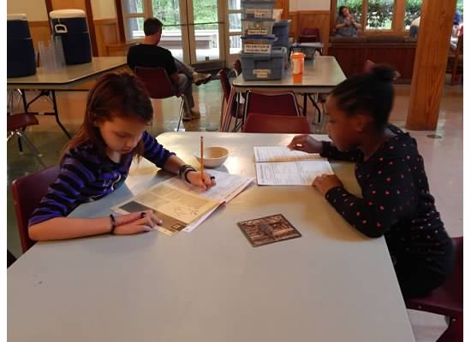
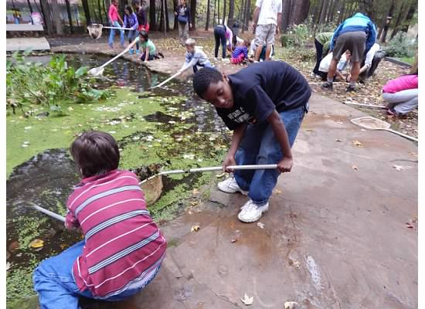
Agenda Con’t.
3:00-4:00 Scavenger Hunt Discovery Box in Discovery Center
(If Discovery Center is in use: “My Changing Neighborhood” Discovery Box on porch)
4:00-5:00 Snack and Erosion Game Discovery Box
5:00-6:00 Relax, Read, and work on activity book. Adults prepare dinner
6:00-6:30 Dinner and clean-up
6:30-7:00 Music with G Barnes

Slide 7
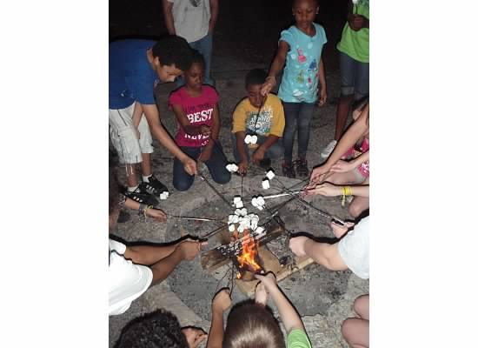
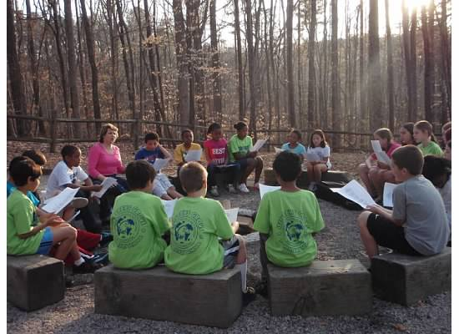
Agenda Con’t.
7:00-7:30 Prepare for night hike; go over expectations and activities
7:30-8:30 Night Hike
Stargazing
8:30-9:30 Campfire stories; rotate students in for showers
9:30 Lights Out

Slide 8
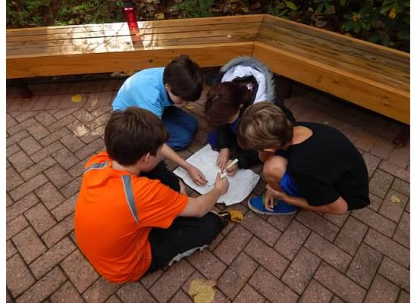
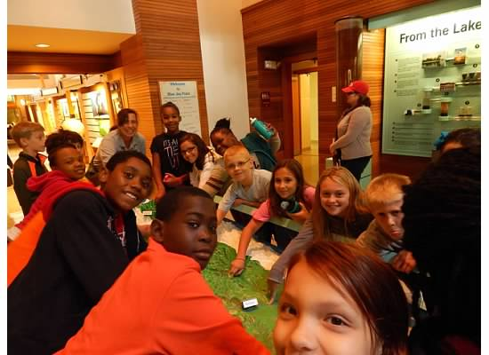
**We understand that students will be extremely tired upon returning to school. The plan for this day is to reflection on our trip, finish the BLP activity journals and watch a movie that relate to the Science curriculum.

Slide 9
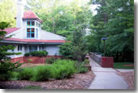
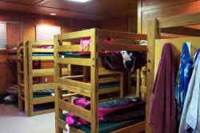
At the Lodge
Modern Kitchen stocked settings for 40 people & all cooking utensils necessary for meals
Great Room with gas fireplace, couches, & tables
Outdoor amphitheater with seating & campfire
Telephone for emergencies
In the Lodge, there are nine sets of bunk beds in each of two single sex sleeping rooms that accommodate a total of 36 overnight visitors (18 on each side).

Slide 10
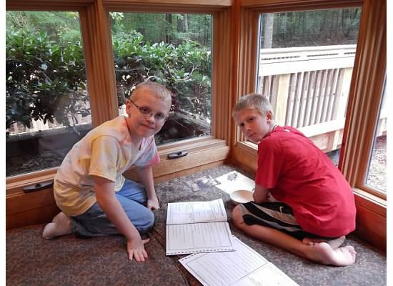
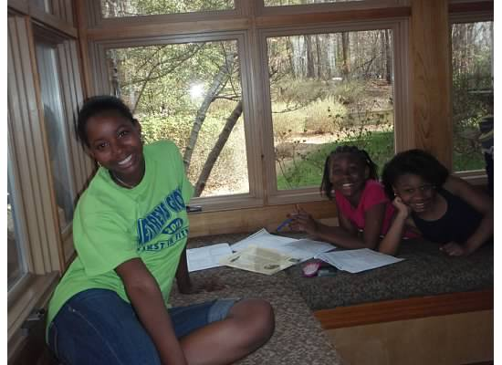
The Lodge Con’t.
The Lodge is designed to accommodate school-aged children through adults,
Please make arrangements for younger siblings.
Safety precautions for small children are not in place.
Pets are not allowed at the Lodge

Slide 11

What to bring
Try and only bring 2 bags- students are responsible for carrying their belongings!
Required
Warm Clothes – layers for being outside and extras
in case of wet weather or an accident
Clothes for day 2 (including undergarments)
Pajamas
Close-toed shoes (2 pairs)
Socks (2 pairs)
Bed Linens (pillow, sheet, blanket or sleeping bag) – please wrap all sleeping materials together
Toiletries (towel w/plastic bag, toothbrush, deodorant, etc)
Lunch for day 1 packed in a paper bag
Reusable water bottle
Optional (students will be responsible for all personal items)
Flashlight
Book, journal
Camera
Prescription Medication with Homeroom Teacher
  (if medical forms have been complete prior to trip)

Slide 12
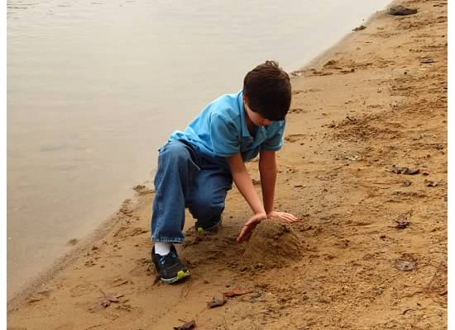
(and not bring)…
If any of these items are brought, they will be locked up for the duration of the trip!
Valuables (including money)
Electronic devises
(cell phones, mp3 players, hand-held games)
Candy, gum, soda
Lunch boxes (all lunches need to be bagged)

Slide 13
Cleaning Up
All groups will be required to carry out clean-up activities prior to vacating the premises.
These will include:
Stacking tables and chairs in the Great Room.
Sweeping entire building, including porch/deck areas (we will mop after you leave).
Cleaning counters in kitchen, bath and bunk areas.
Loading and running dishwasher (unloading is preferred, but optional).
Cleaning and putting away pots & pans, etc.
Removing all belongings, including food from the refrigerator.
Pulling all trash (bunk room, great room, kitchen, baths) and putting it on the back porch.

Slide 14
The Gate
The park closes at sunset. Exact times can be acquired by calling Blue Jay Point. Teachers will be provided with keys to the front gate and Lodge, and a member of Blue Jay Point’s staff will be “on-call” during your stay.
Teachers will be responsible for the gates and members of your group entering and leaving the park after closing. Please plan accordingly.
Evening use of the park is limited to the Lodge area, unless proper scouting has been done in advance during daylight hours to check for hazards (park maps are available). DO NOT PARK ON THE STREET!
Park is open Monday–Sunday, 8 a.m.–sunset
Feel free to go with your child ahead of time
to the park to explore!

Slide 15
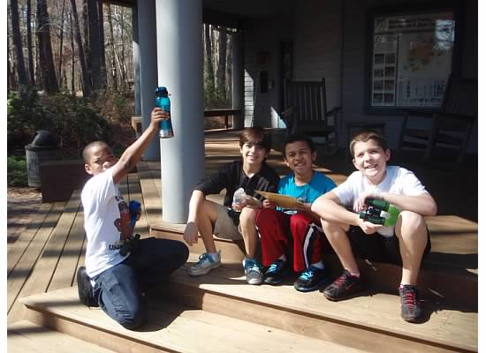
Contact Information
3200 Pleasant Union Church Road, Raleigh, NC
Education Center (919) 870-4330 ‎ (8:00am- 5:00pm)
E-Mail: bluejaypoint@wakegov.com
Emergency Contact (919) 870-4325 (after 5:00pm)

Slide 16
Volunteers – We NEED Your Help!
Before BJP:
Shop for class groceries and deliver to BJP after 1:00pm
Prepare dinner meat in advance
Suggested: 1 chaperone to every 5 students
Day One chaperones
Dinner Prep and Serving
Male and Female Overnight Chaperones
(limited due to lack of accommodations)
Day Two chaperones
Breakfast Prep and Serving
Clean Up

Slide 17
Questions?

